Slide 1
WELCOME TO GIRLS EMPOWERED BOOK CLUB!
KELLIE BYNUM LATHAN, FOUNDER

Slide 2
ABOUT US:
Girls empowered book club is a 501c3 non-profit organization with an overall vision of empowering, enlightening, engaging, and entertaining girls in grades 3-8 through dynamic book discussions. The mission of this book club is to build a culture of girls who enjoy reading while advancing literacy skills that are centered on five core values:
1. Engage with community leaders to build effective leadership skills, establish career goals, and participate in community service projects
2. Help girls to develop a positive self-image, build self-confidence and instill outstanding character
3. Develop effective communication and critical thinking skills
4. Create life experiences that foster a global outlook impacting social change
5. Develop effective problem solving and decision-making skills that advocate positive relationships

Slide 3
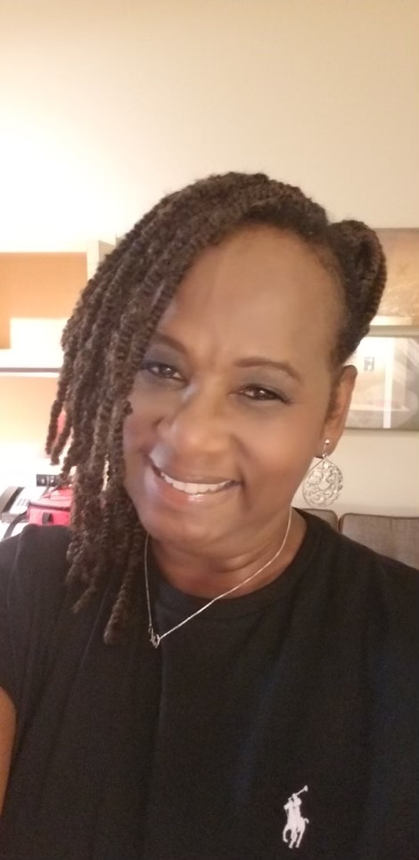
Our Founder:
Kellie Bynum Lathan is a passionate reader who has a vision for building a culture of girls who enjoy reading. Her love for reading began as a young girl who read books as a journey to escape and find joy in meeting new characters in different settings. She has over 30 years in the East Baton Rouge Parish School System as a Speech Therapist. This book club is her yes to her calling.

Slide 4
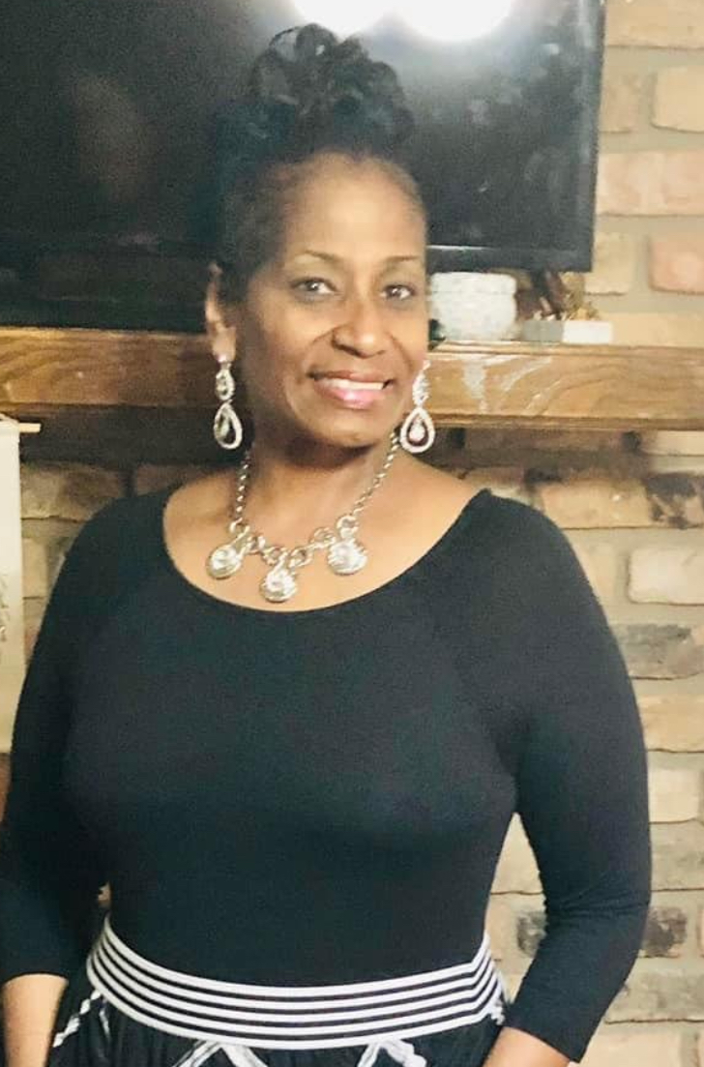
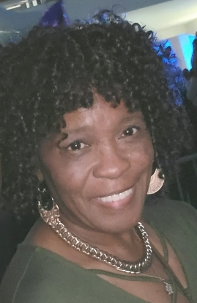
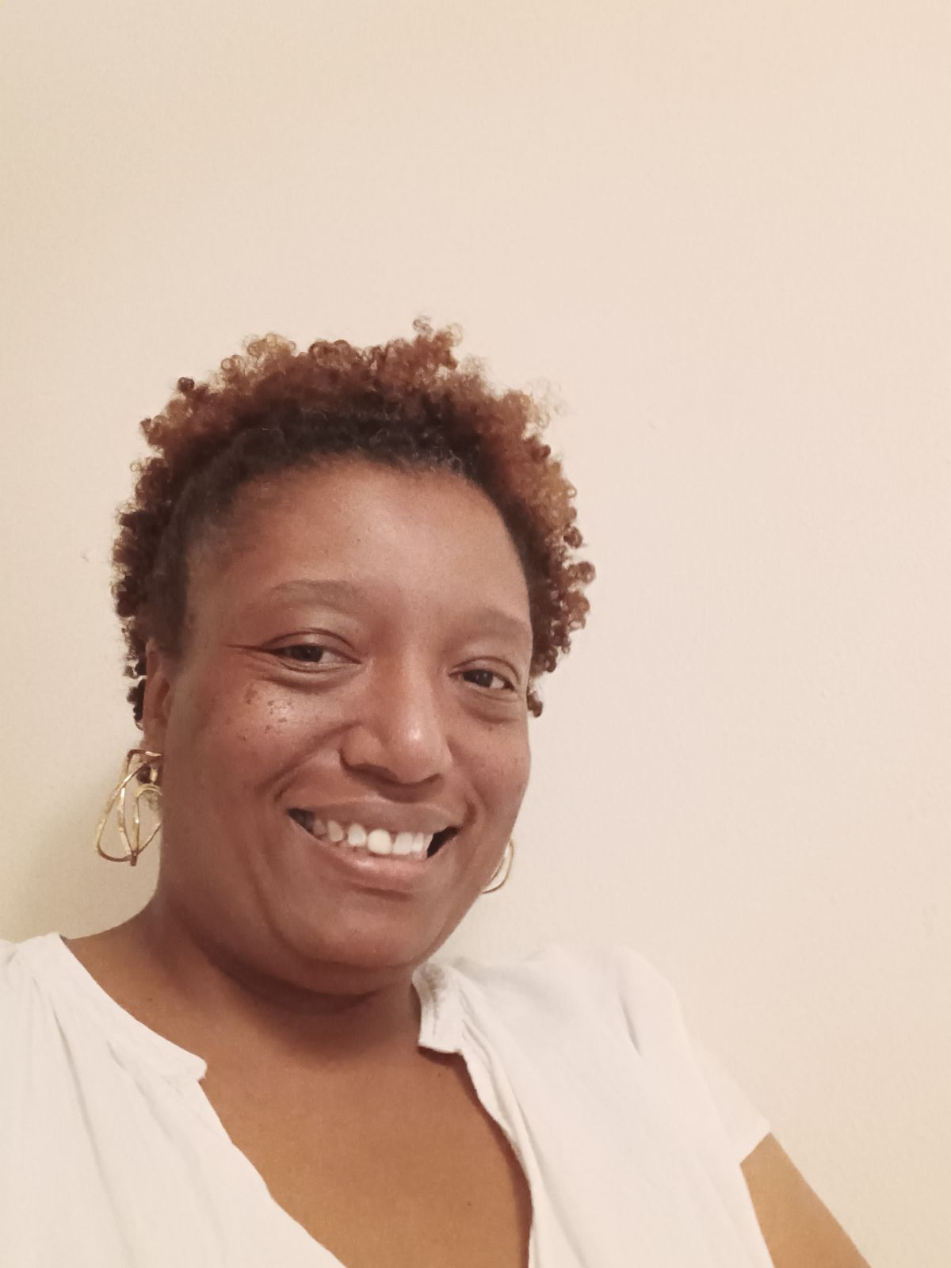
Our Program Coordinators and Administrative Assistant
Rebecca Holloway
6th-8th Grade
Sharon Williams
3rd-5th Grade
Tandra McCastle
Administrative Assistant
Rebecca Holloway holds an education specialist certification in curriculum and instruction with a specialization in science from Louisiana State University and earned a Master of Education plus 30 from Southern University. Ms. Holloway currently serves as an introduction to STEM pathways and careers, 6th/7th grade Science and Engineering design teacher at Park Forest Middle Magnet School. She currently serves in multiple leadership roles including grade level coordinator, PBIS coordinator, East Baton Rouge Parish /Mentor Teacher, and Teacher Leader for Middle Schools. She has presented workshops on the national, state and local level. She has a passion for reading and literacy and is dedicated to ensuring that our girls grow into lifelong learners.
Tandra Mccastle is our administrative assistant for GEBC. She is passionate about seeing all kids learn in every aspect of life. Reading is very fundamental when it comes to learning. She enjoys sports, traveling, eating, bowling, and the movies.
Sharon Williams is a dedicated educator who served with the East Baton Rouge Parish School System for eleven years as a Para-Educator. In the classroom, she was committed to instruction that was designed to meet the various needs of her students. Her passion as an educator made a significant change in the academic, social and emotional needs of her students.
She is a mother, grandmother, and a life-long nurturer who brings creativity, compassion, and inspiration for our girls. Sharon is dedicated to enhancing the lives of our girls with wisdom and motivation to push our girls to their fullest potential.

Slide 5
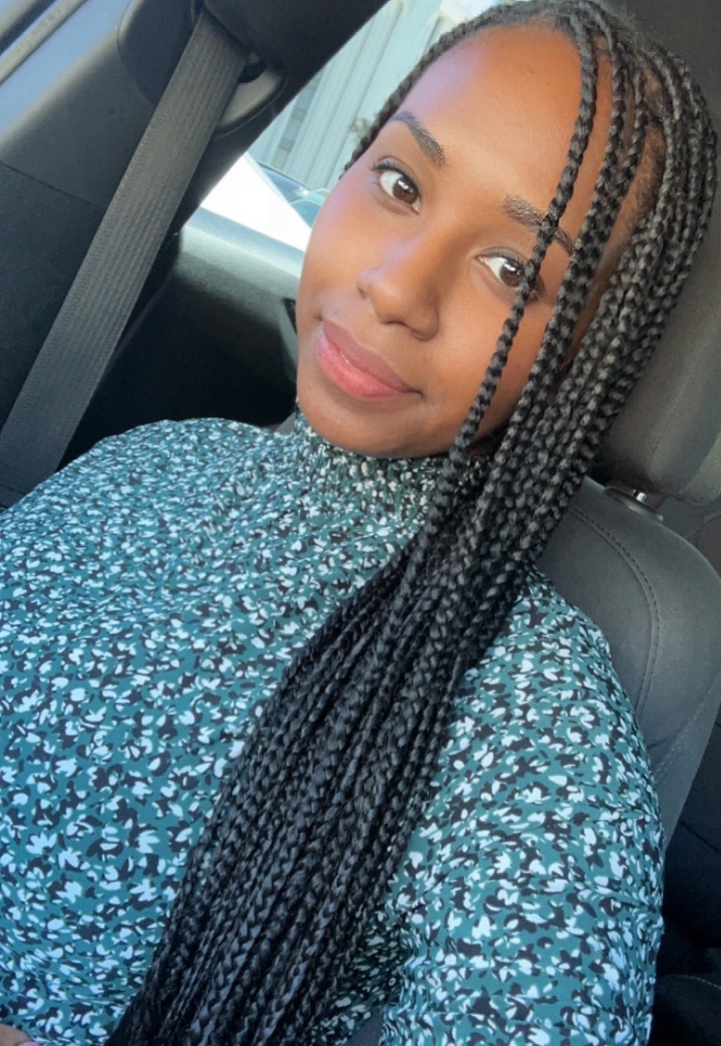
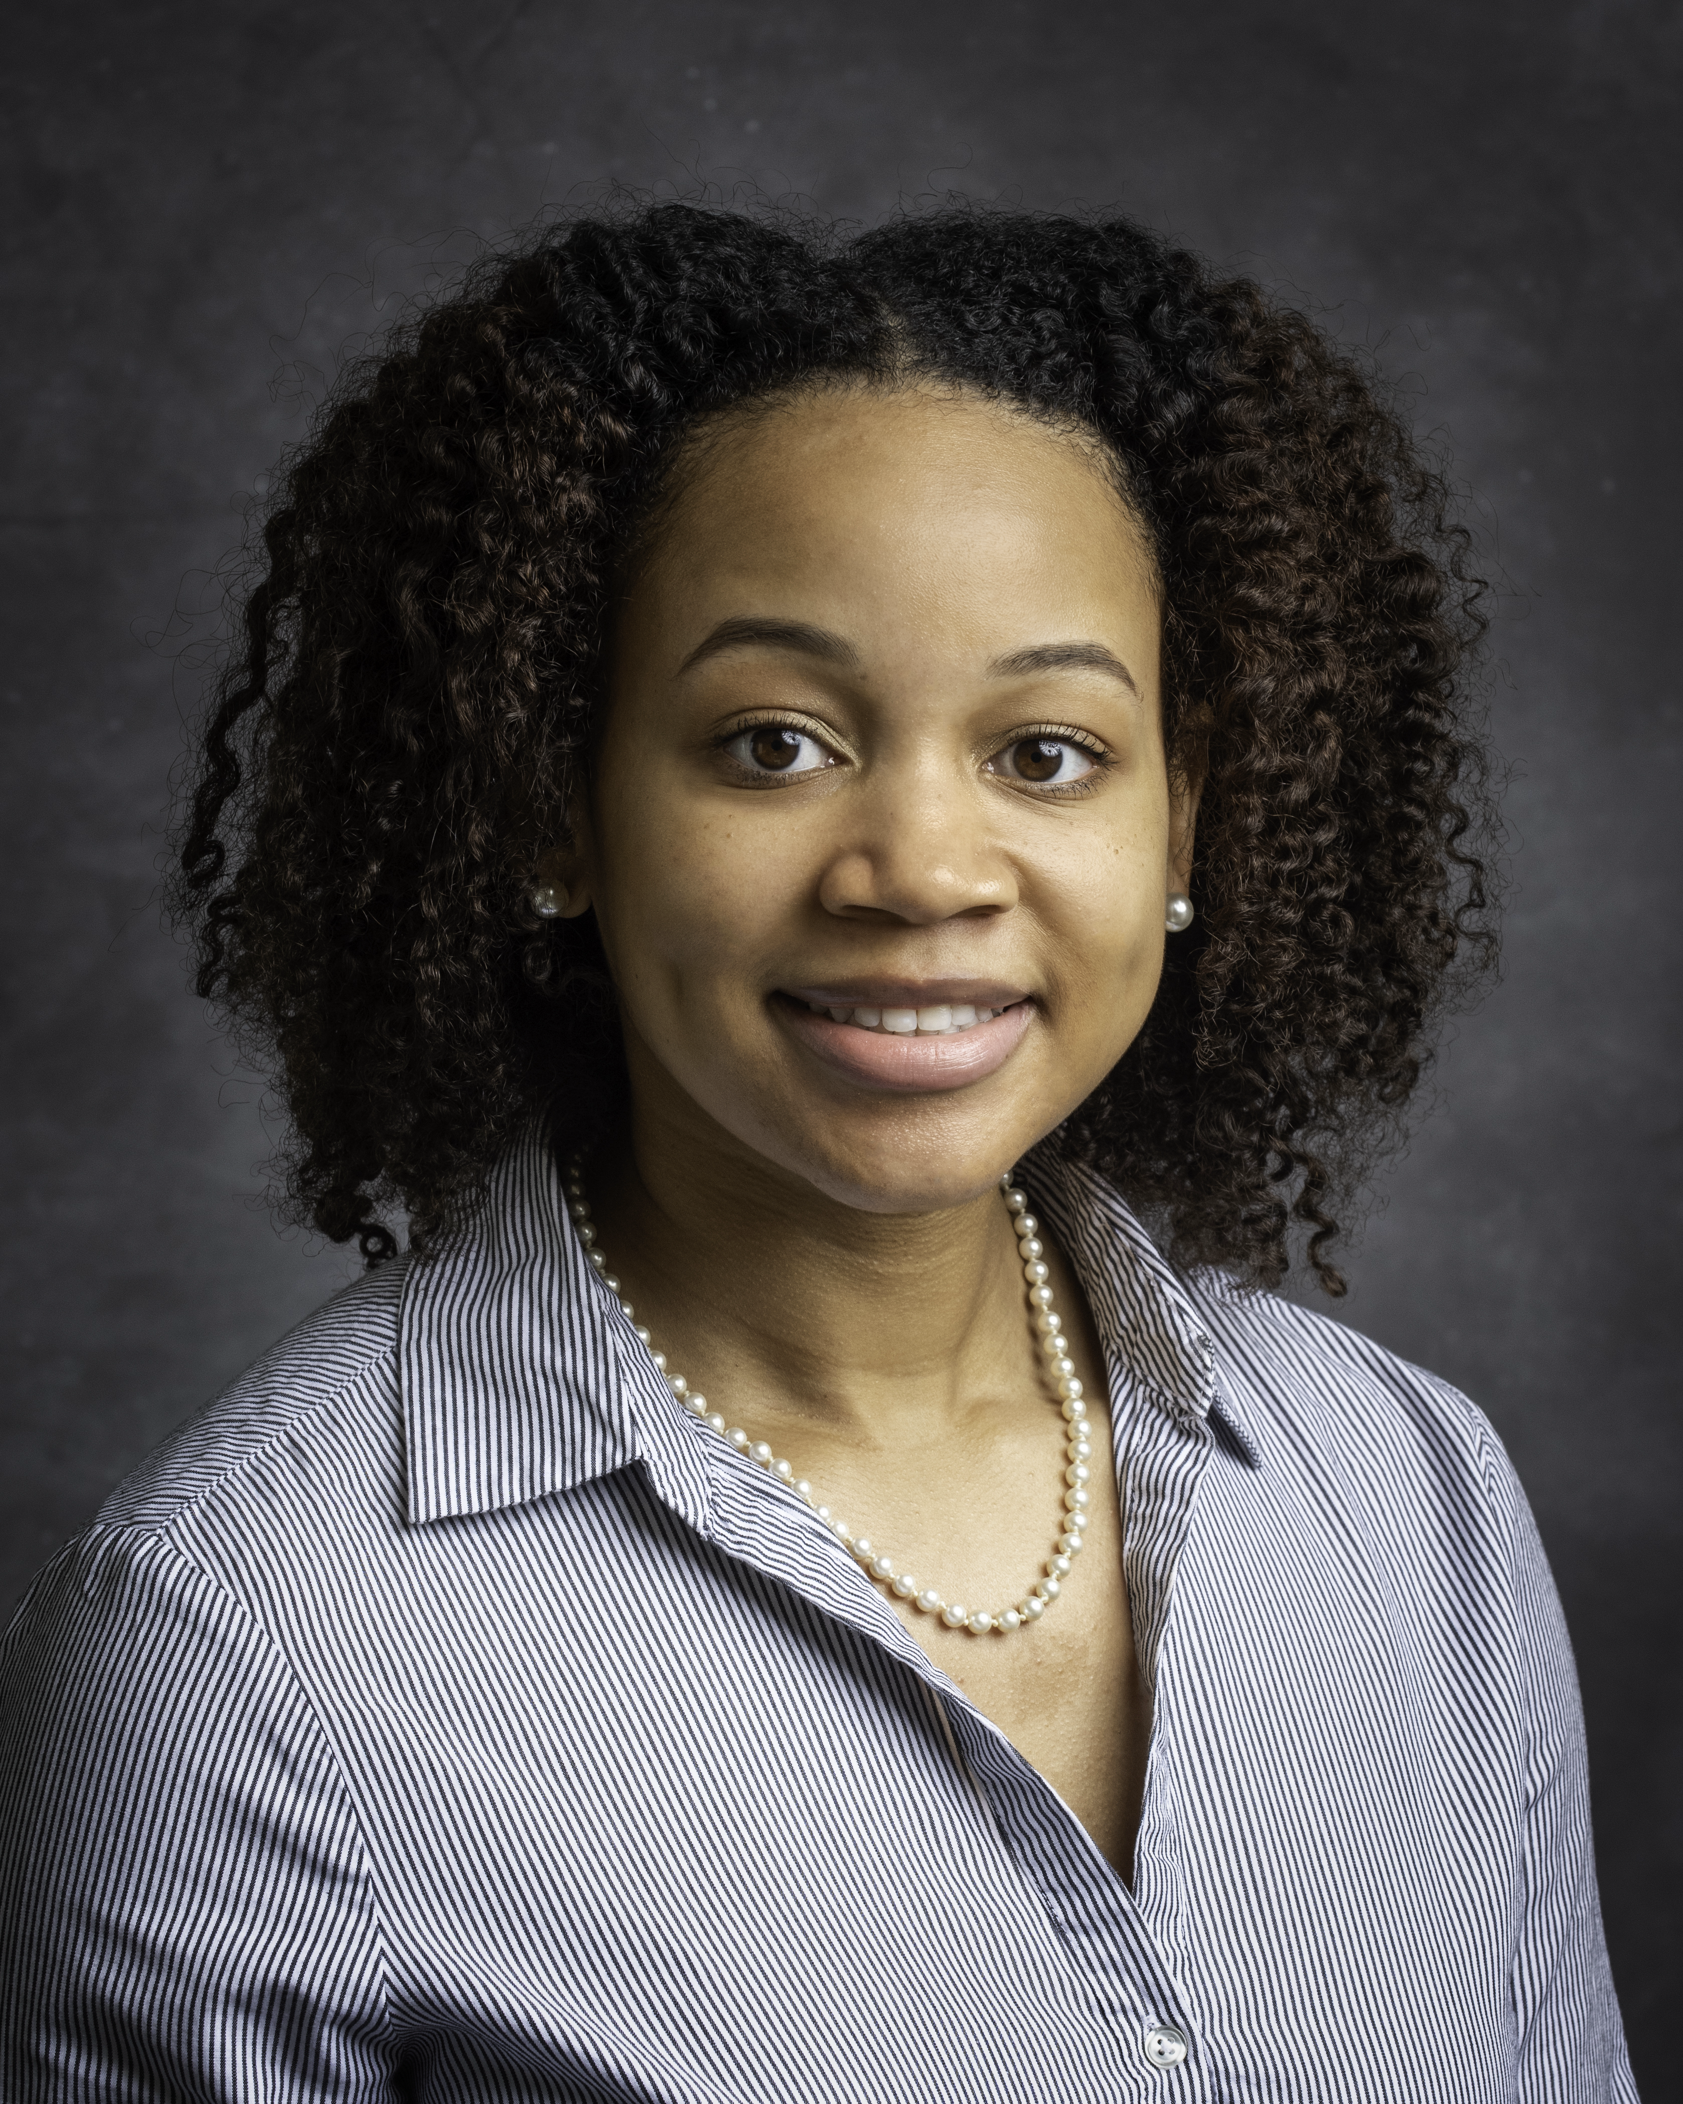
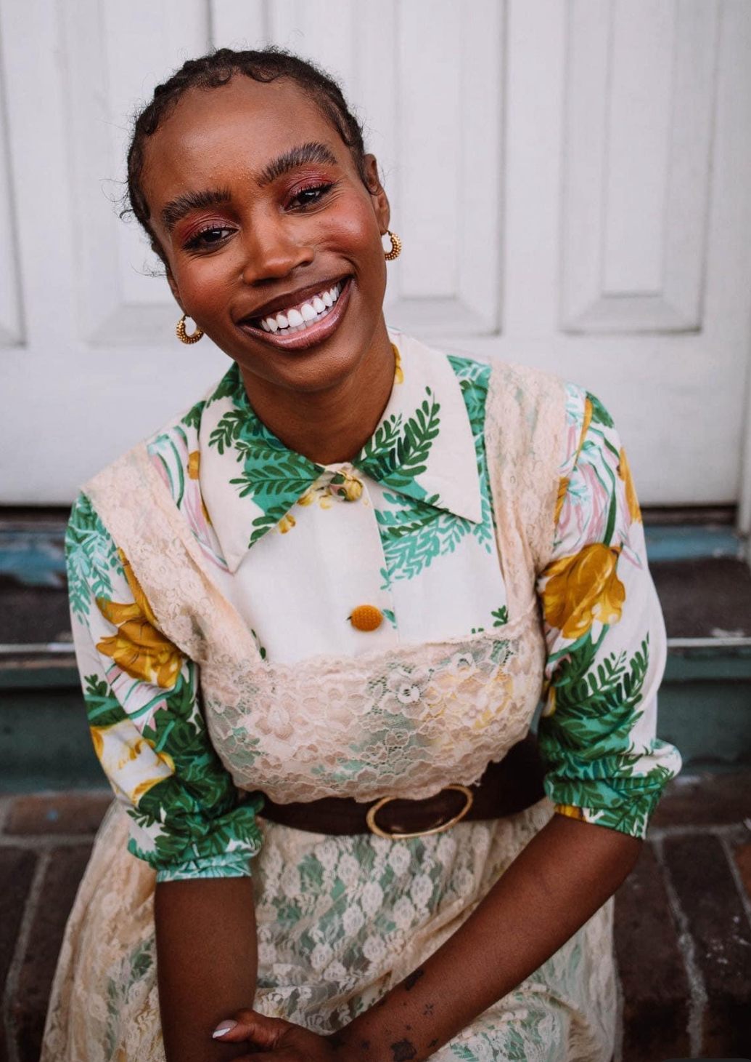
Meet our Volunteers
Dynesha griffin
Glenda harris
Tiffany Hill
Dynesha Griffin is our 3rd-5th grade volunteer. She is a graduate of LSU and is currently working as an administrative specialist at an insurance company. She is an introvert who loves binge watching shows, reading, cooking, and taking nature walks. From shopping to spa dates, she makes sure to take care of herself every chance she gets. Self-care brings her joy!
Glenda Harris is our 6th-8th grade volunteer. She is originally from Mobile, Alabama, but has been a Baton Rouge resident for over five years. She has a bachelor’s degree in Chemical Engineering and is a Process Engineer at WR GRACE. In her free time, she enjoys reading, spending time with friends and families, traveling, and trying new things.
Tti
Tiffany is our 6th-8th grade volunteer. She was born and raised in California. She has a Bachelor of Ccience degree in Fashion and Textile Technologies with a concentration in Fashion Design. In her spare time, she enjoys reading, being outside in nature, playing dress up in clothes and watching movies.

Slide 6
Why join a book club?
Joining a book club has many benefits that are vital to literacy growth and beneficial for personal reflection:
1. Book clubs provide an opportunity for social engagement where friendships are formed.
2. Critical thinking, vocabulary, comprehension, and writing skills are advanced.
3. Readers have a choice in reading material that influences motivation for reading and engagement.
4. Accountability for reading is on high alert as participants are expected to read and prepare for fun and engaging activities.
5. Exposure to various genres can be expected.

Slide 7
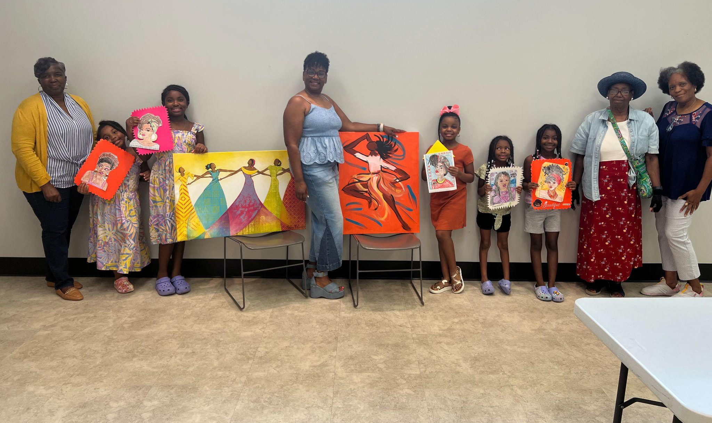
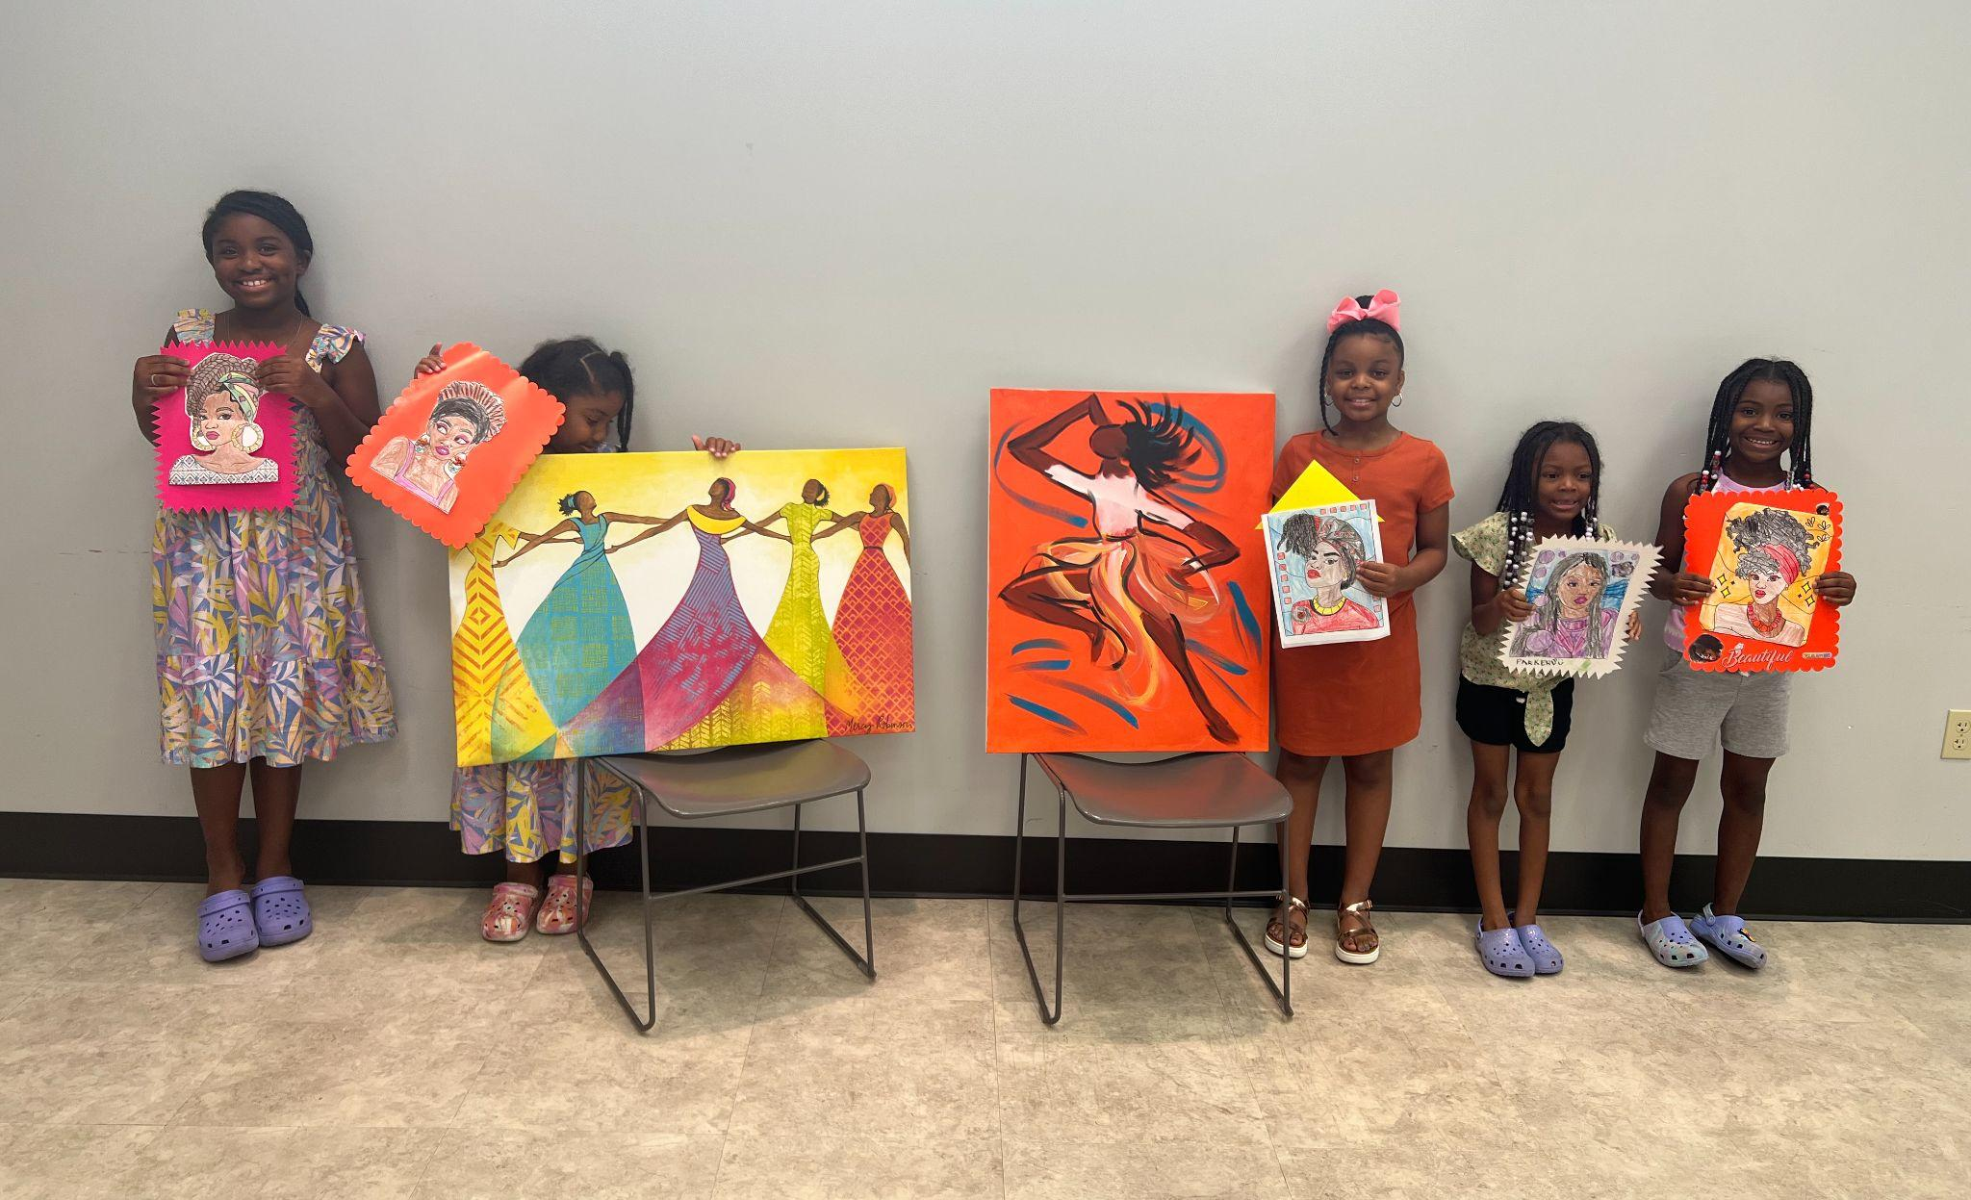
Our Beginning…..
We began our girls book club in july of 2023 with 5 girls. We read my hair is a garden by cozbi cabrera. The girls enjoyed listening to the book on youtube and coloring different hair designs. They had a blast!!

Slide 8
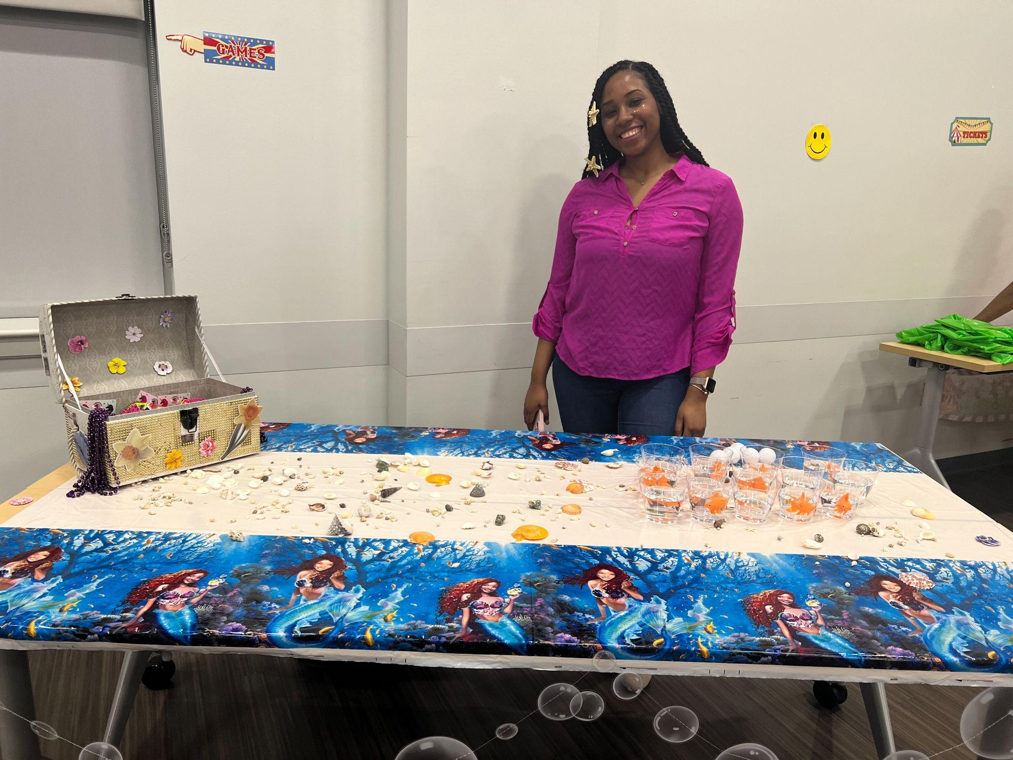
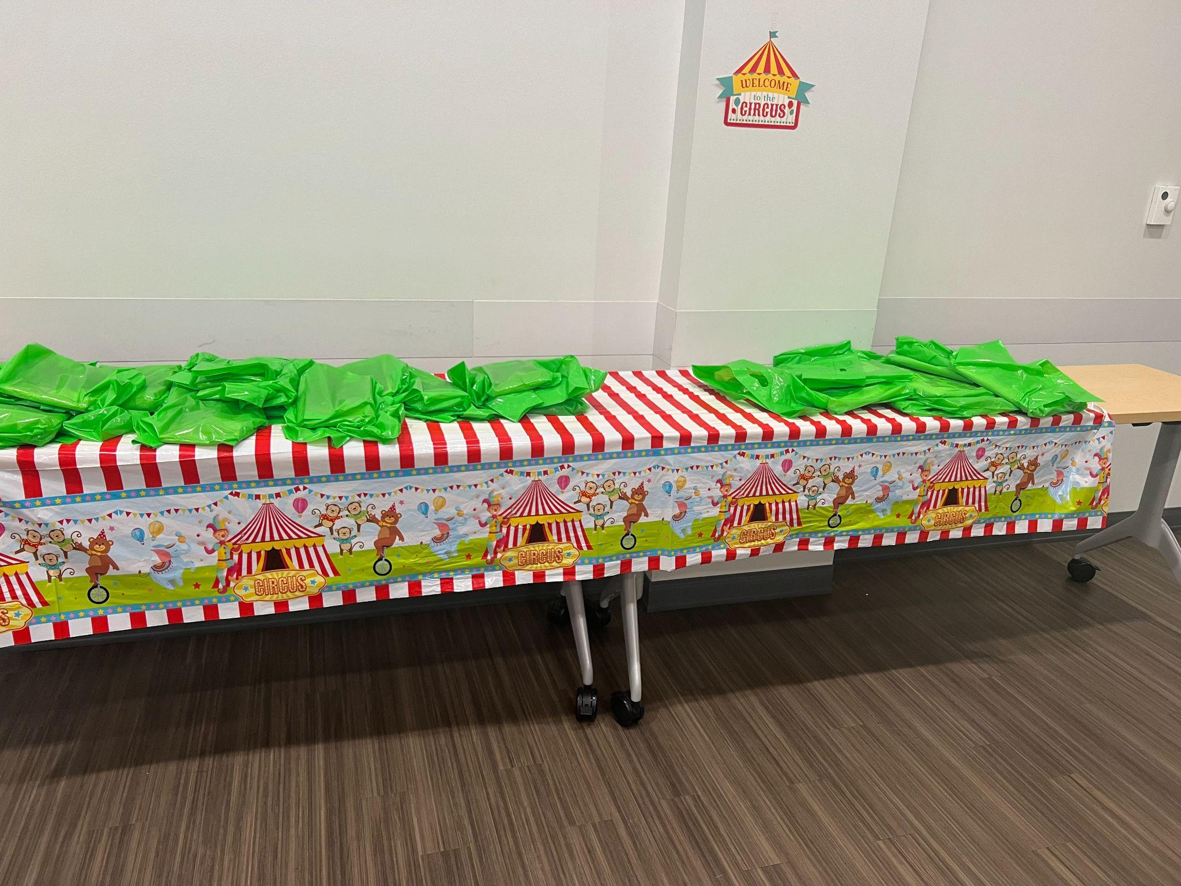
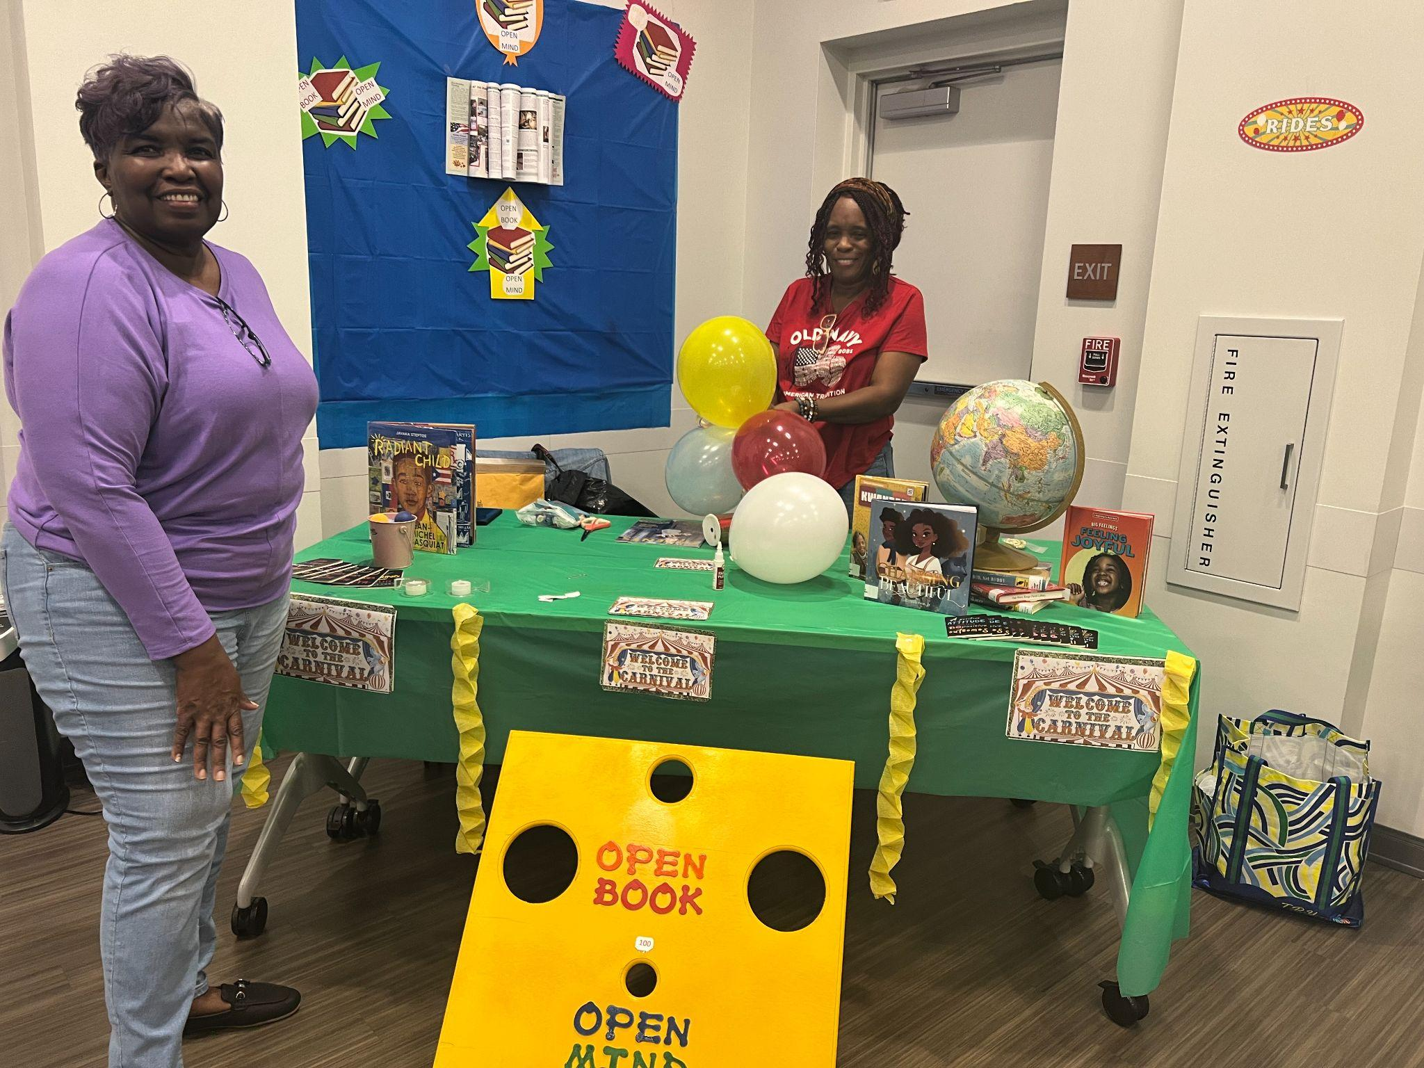
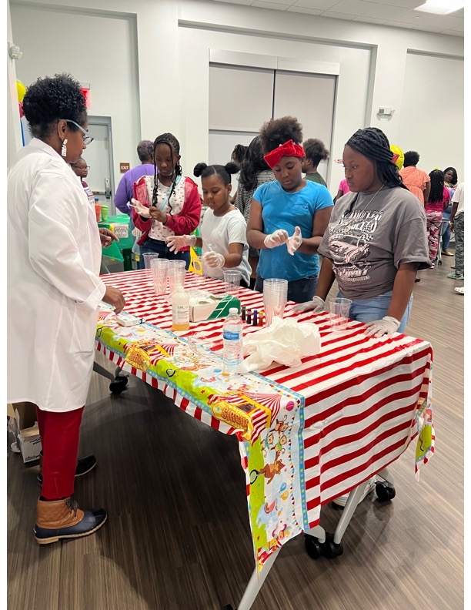
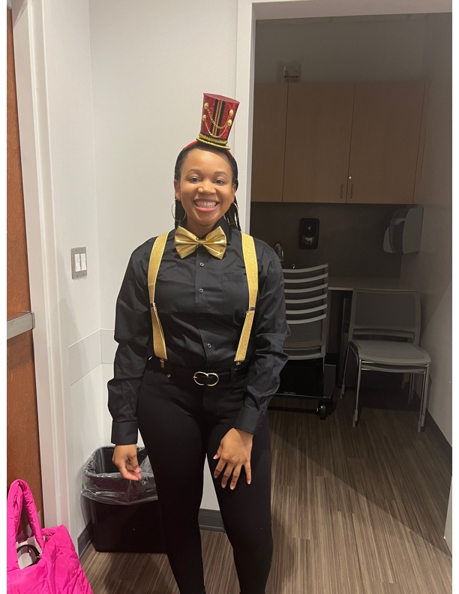
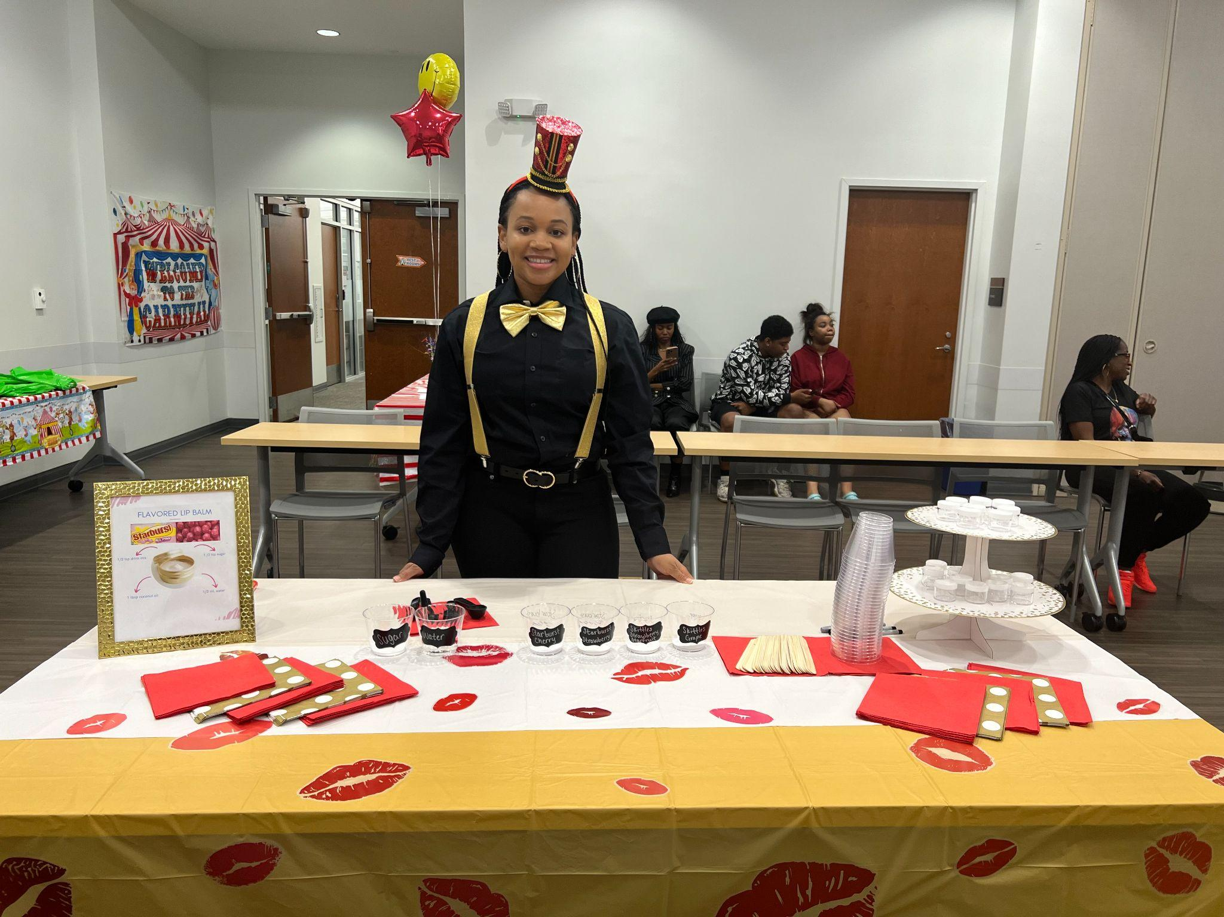
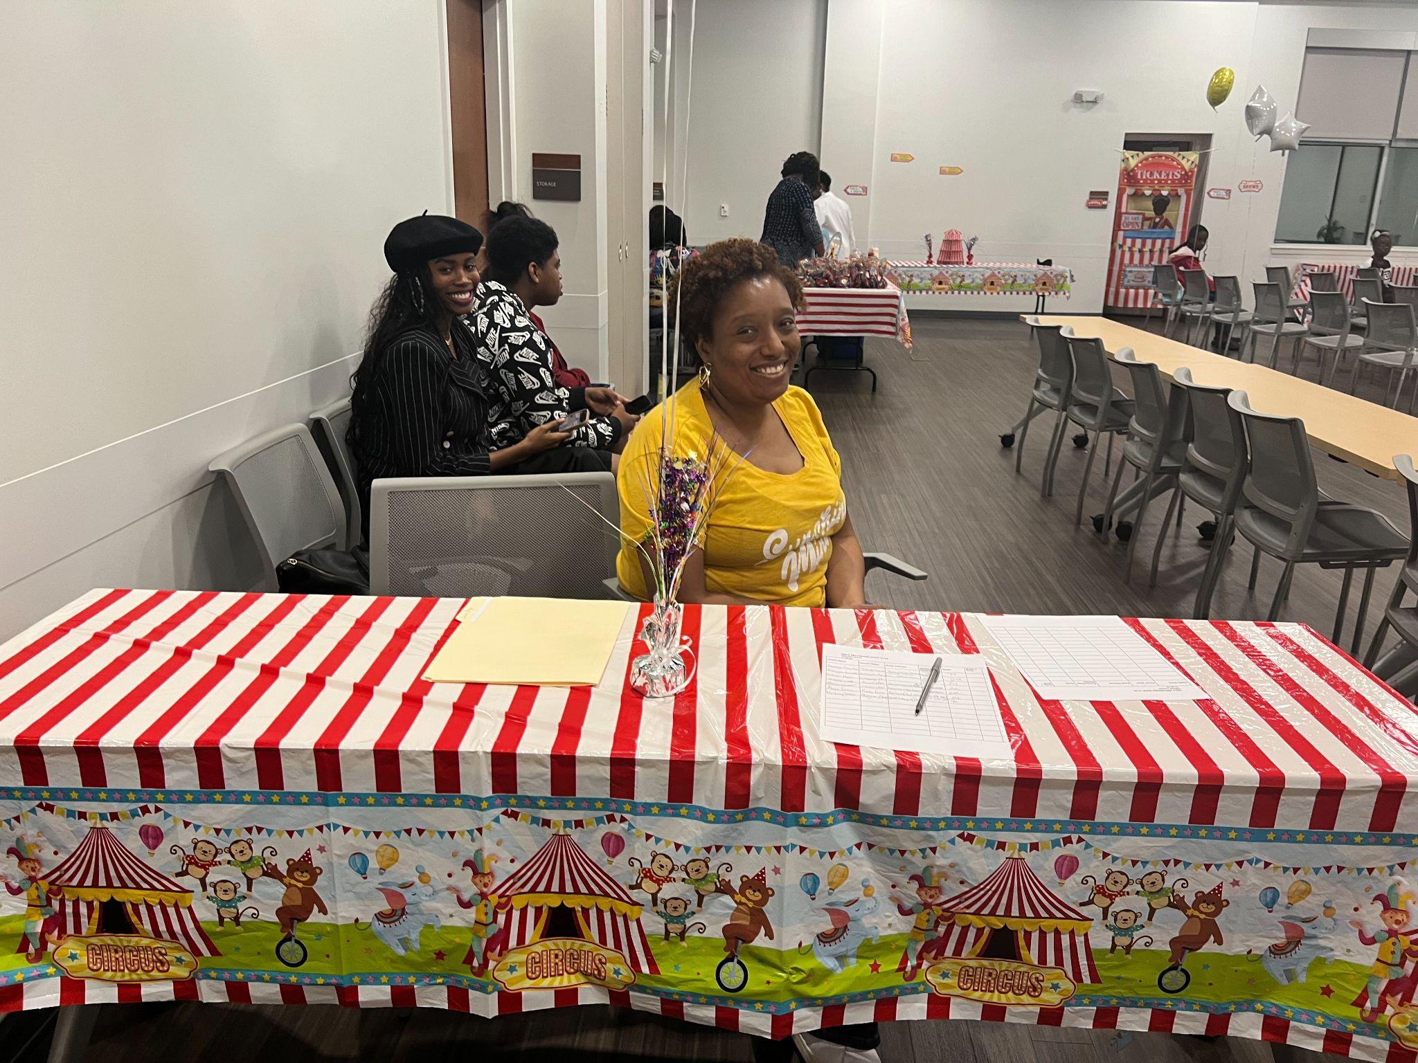
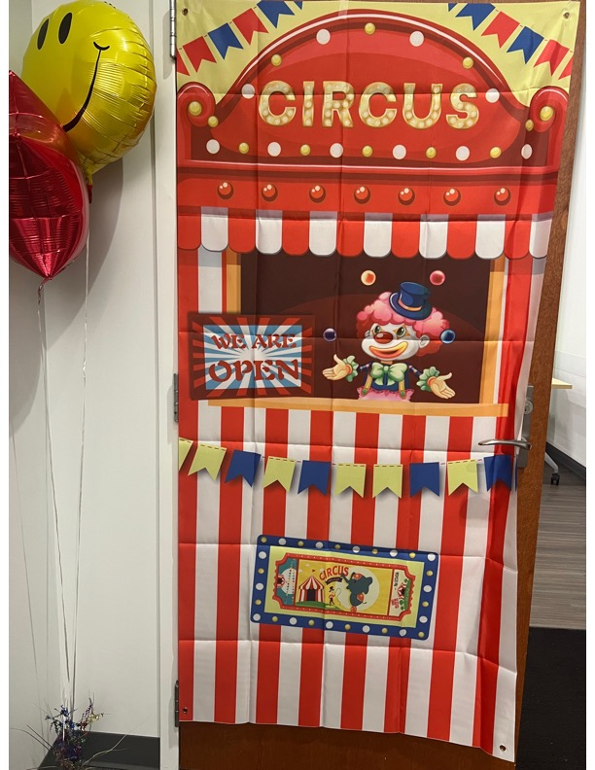
Our Official Launching!!!
For our official launching, we held a book carnival on November 20, 2023, with four fun interactive STEM stations that offered hands-on activities. We invited three young ladies to give inspirational messages to motivate ythe girls to join our book club! Each participant received a book, The Skin I’m in by Sharon Flake (grades 6-8) and we re-introduced My Hair is a Garden by Cozbi Corbrera (grades 3-5).We had so much FUNN!!

Slide 9
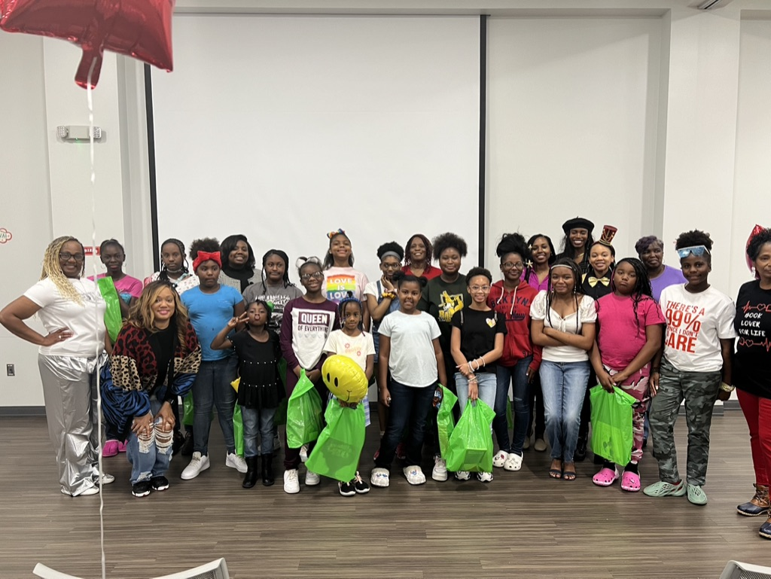

Slide 10
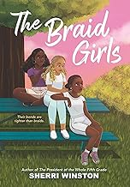
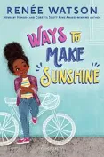
Books that we have read and enjoyed throughout the 2023-2024 school year!

Slide 11
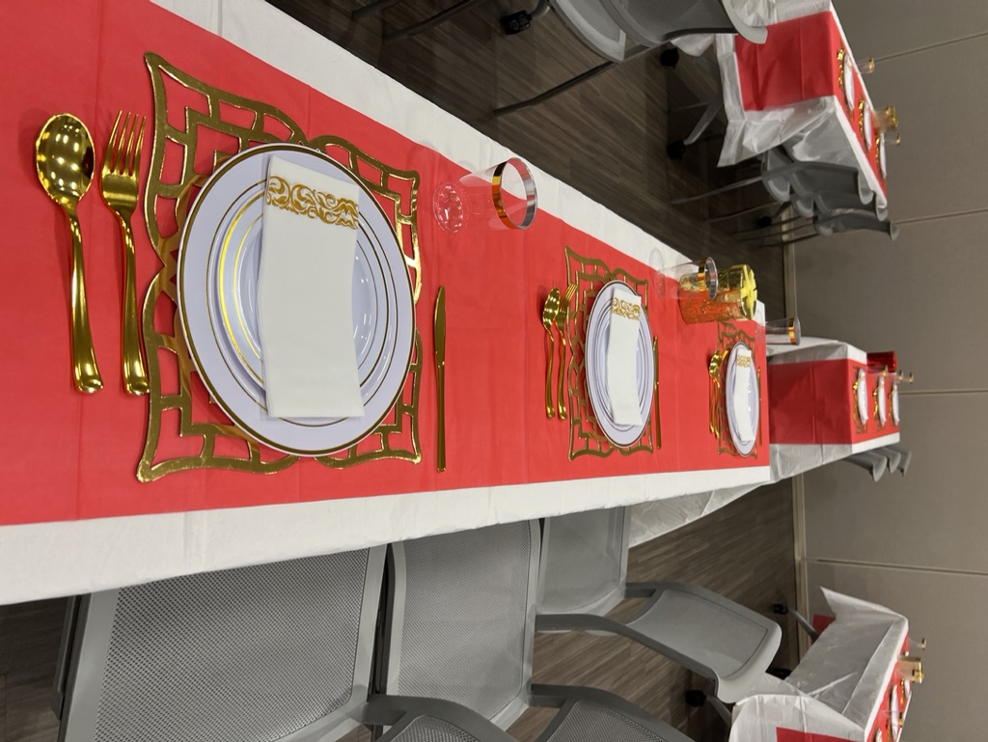
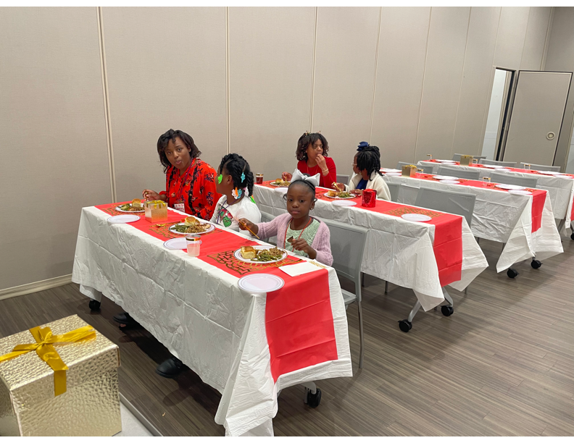
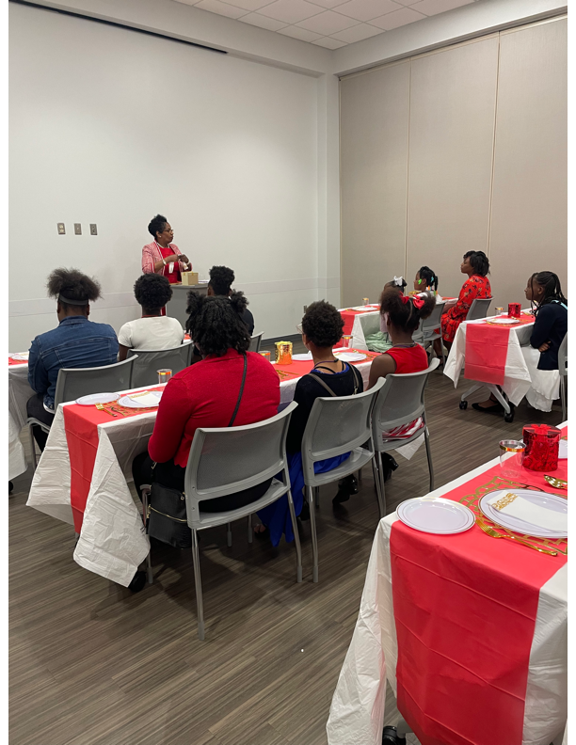

Slide 12
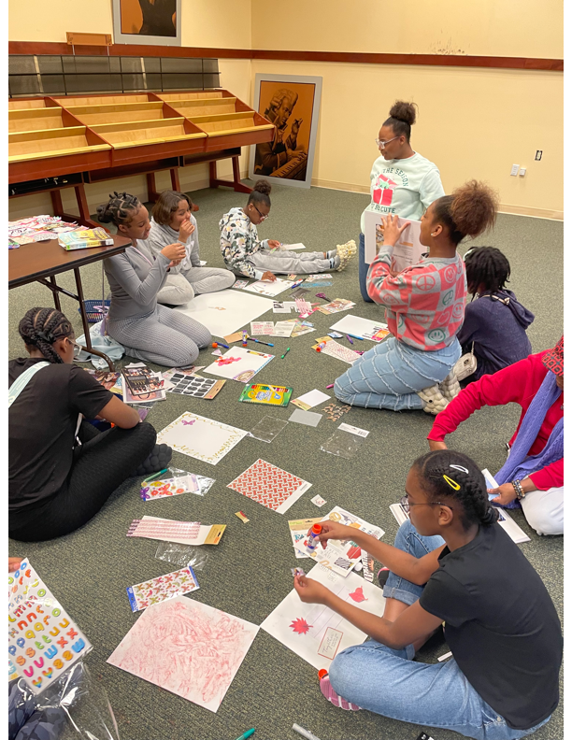
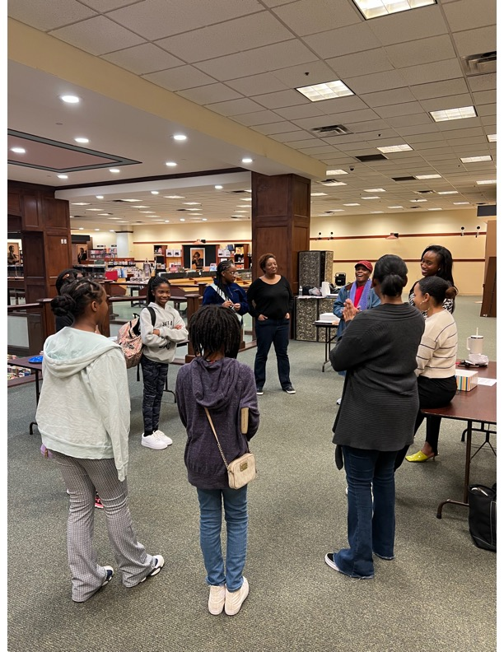
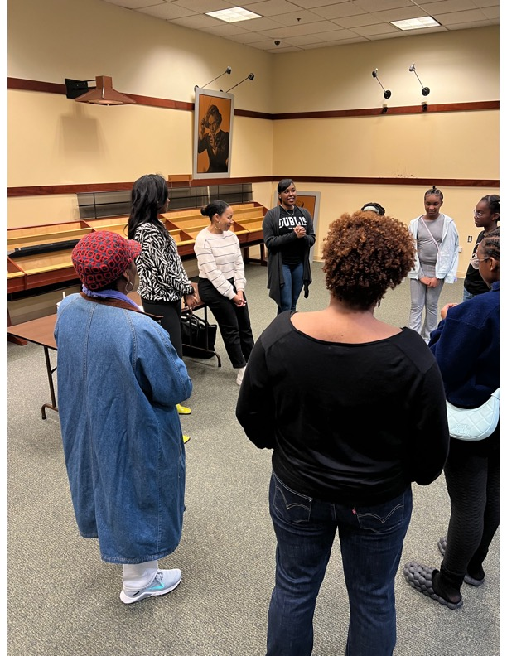

Slide 13
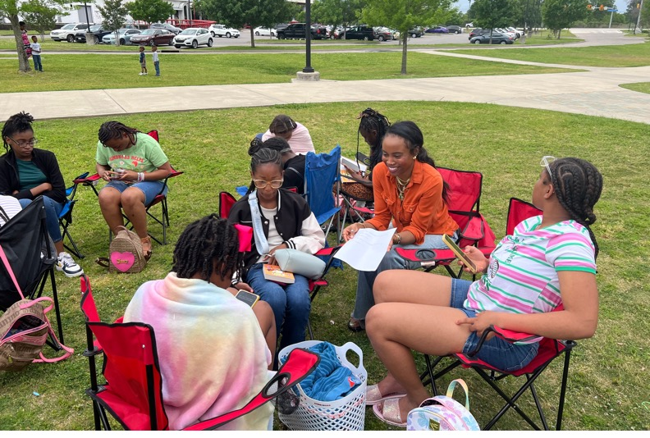
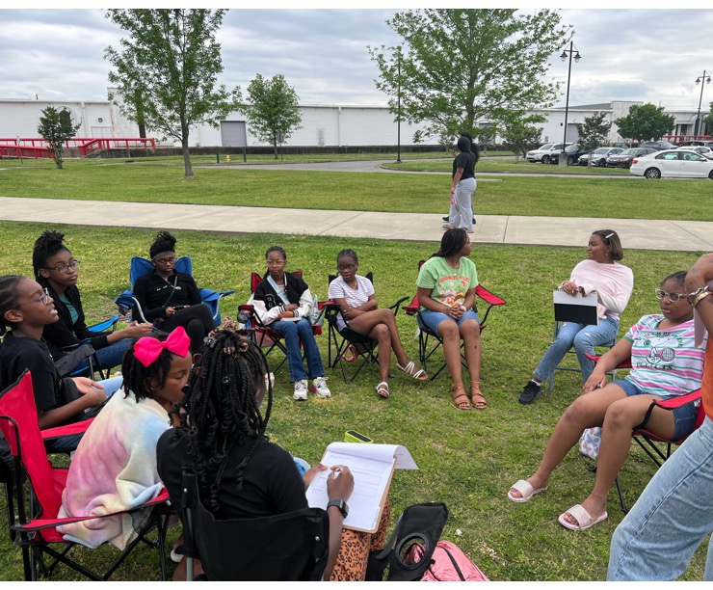
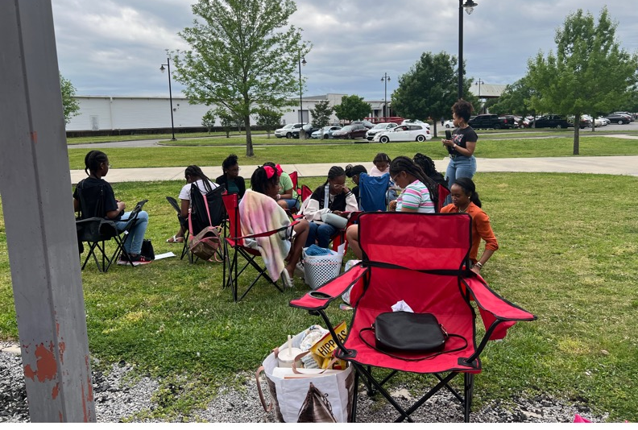

Slide 14
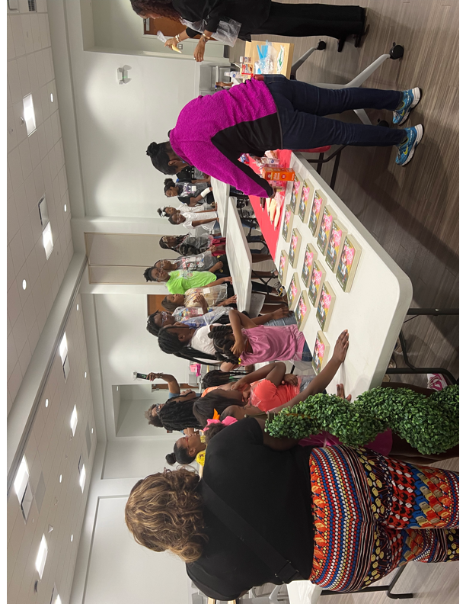
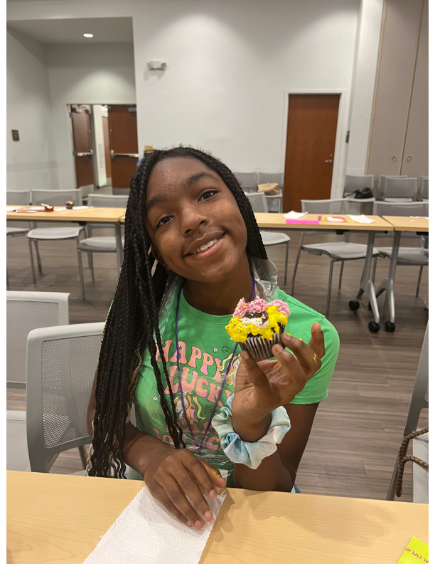
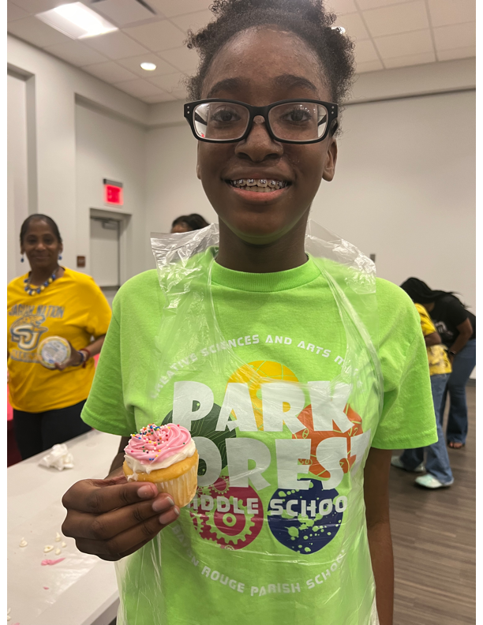
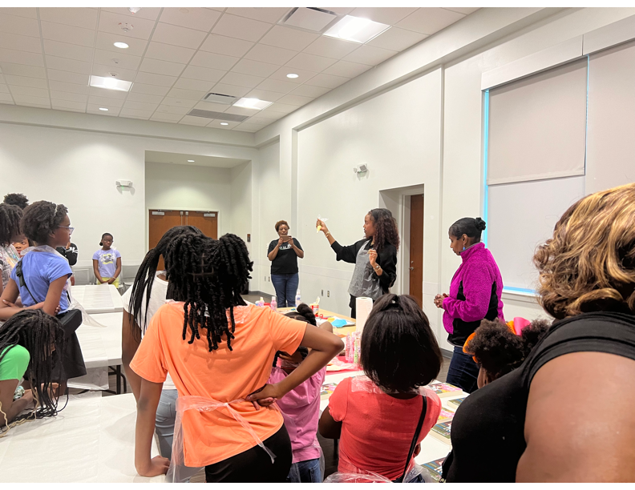
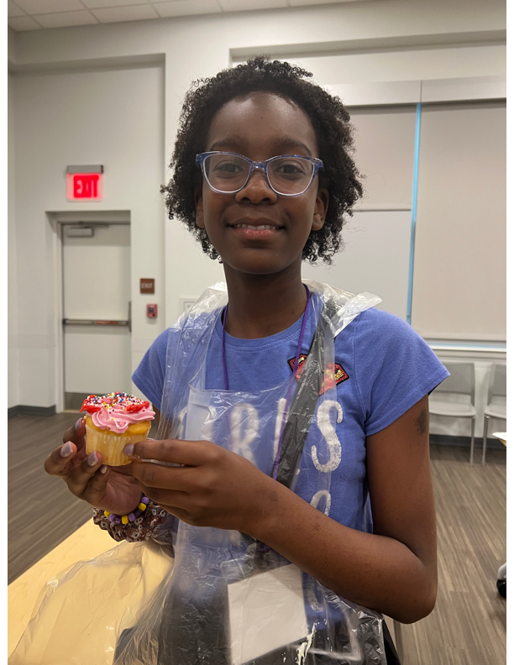

Slide 15
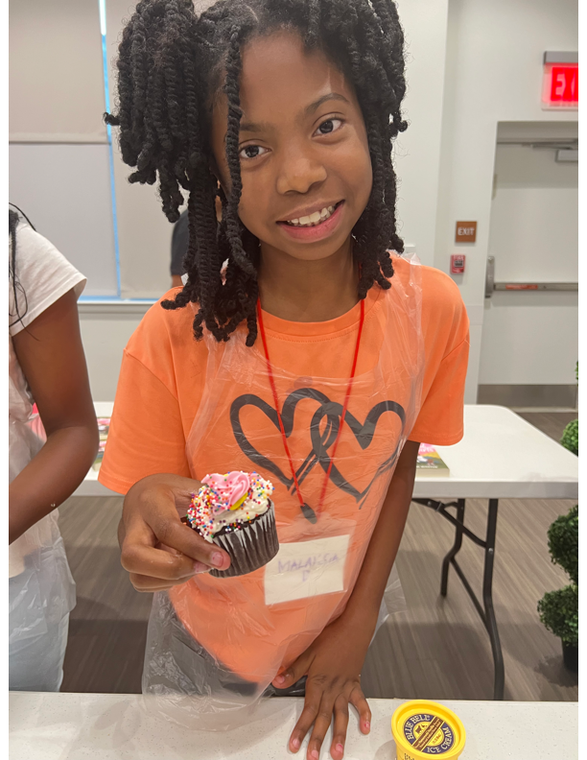
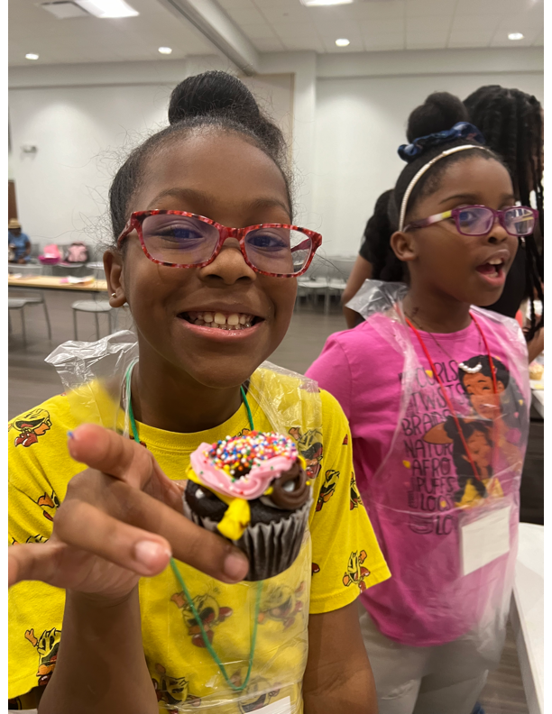
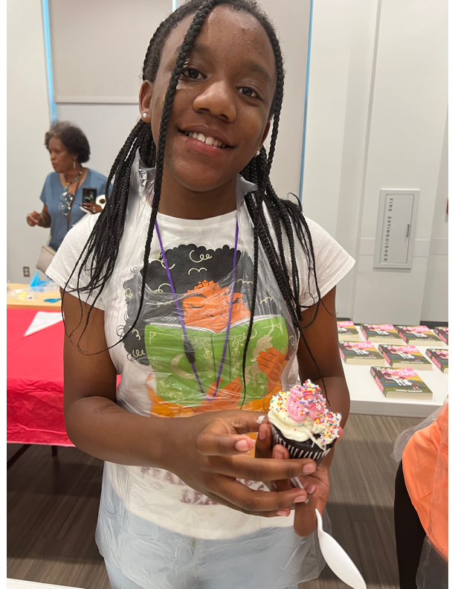
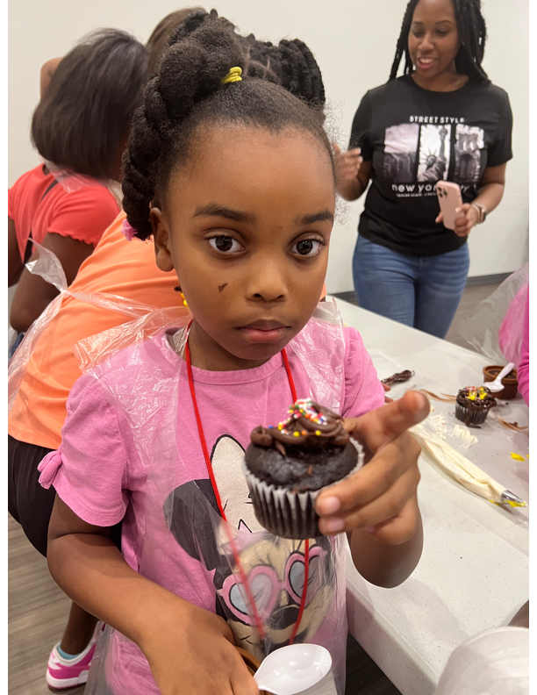
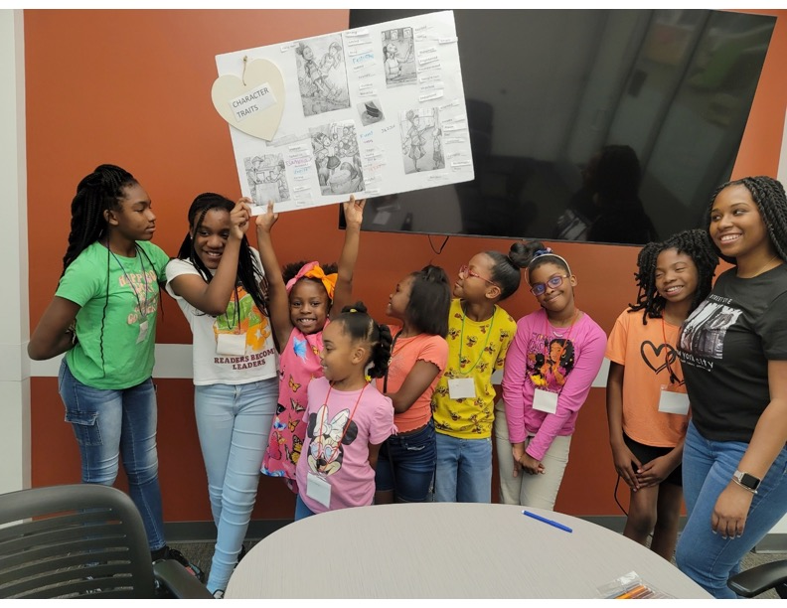

Slide 16
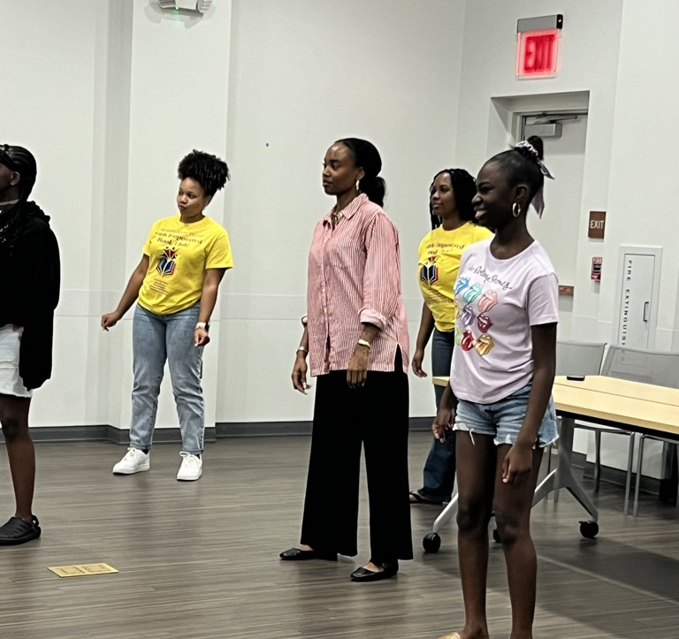
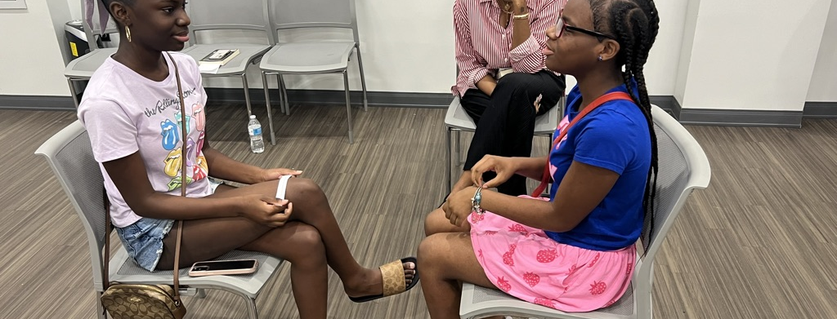
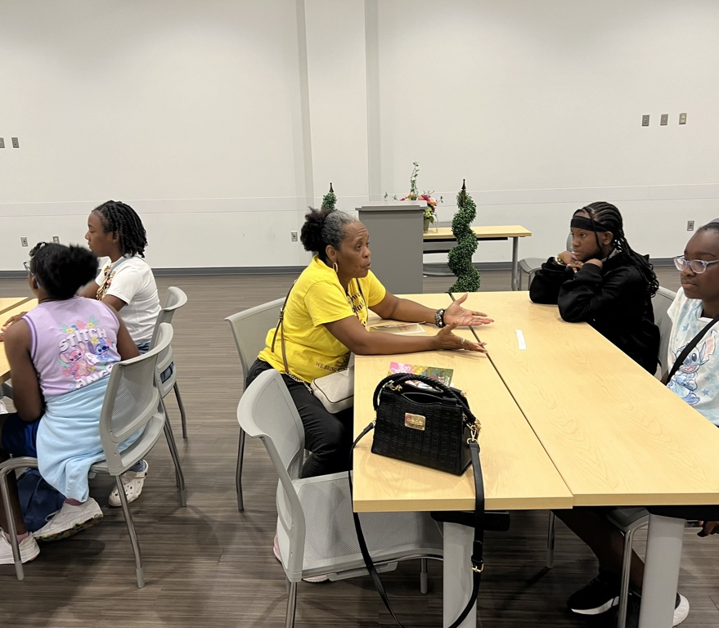
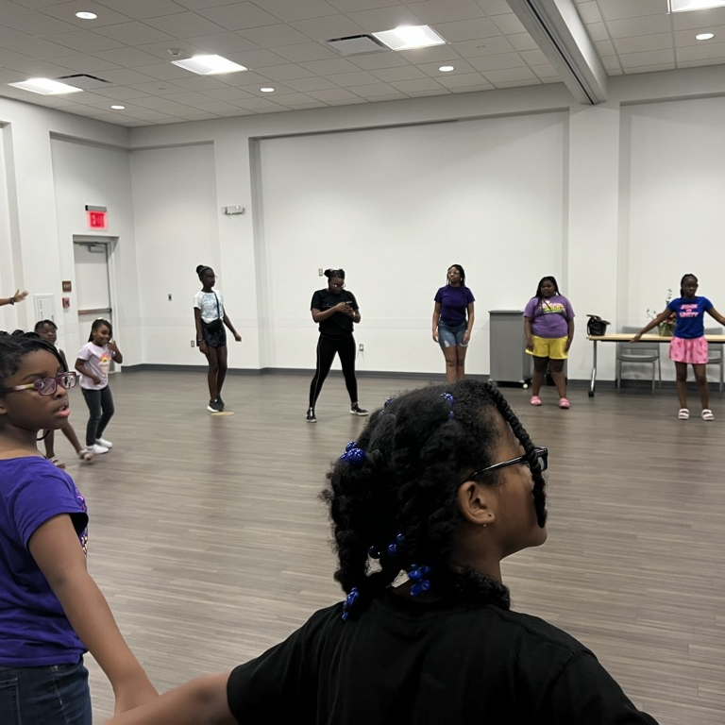

Slide 17
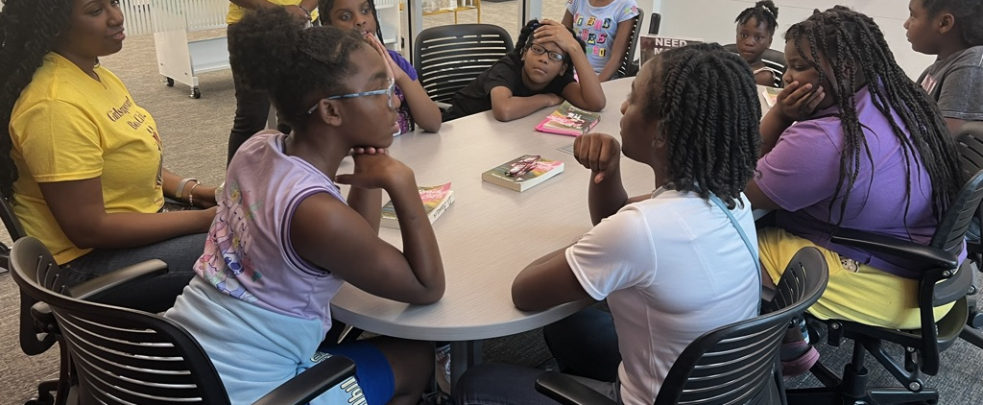

Slide 18
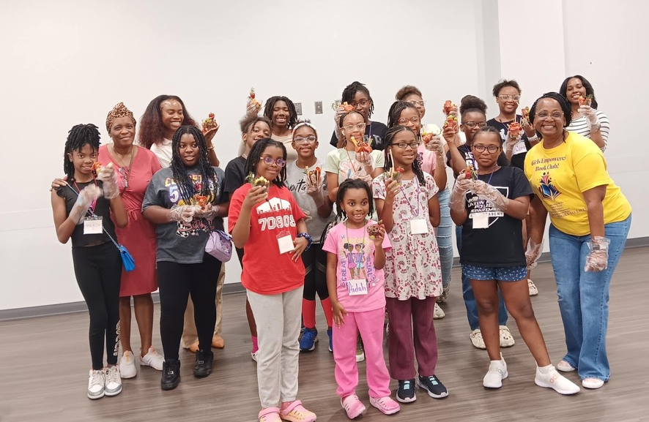
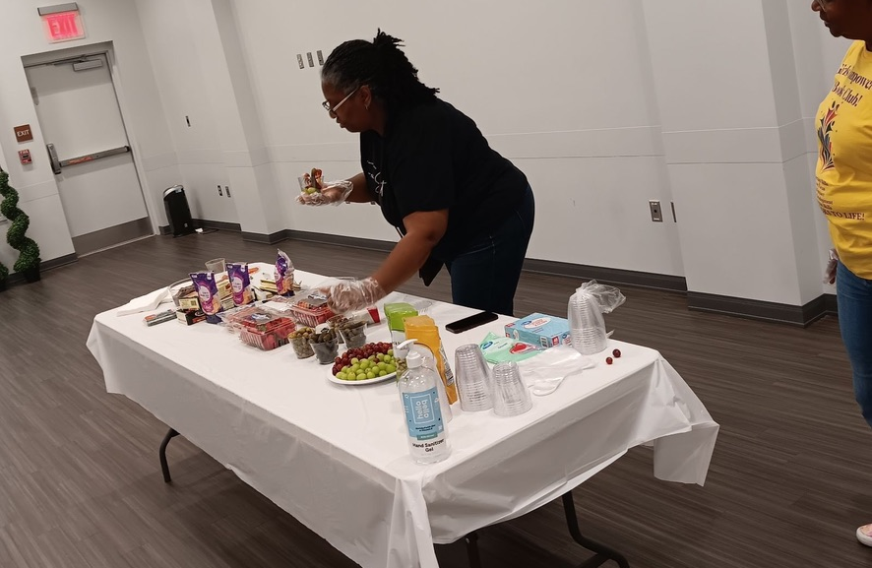
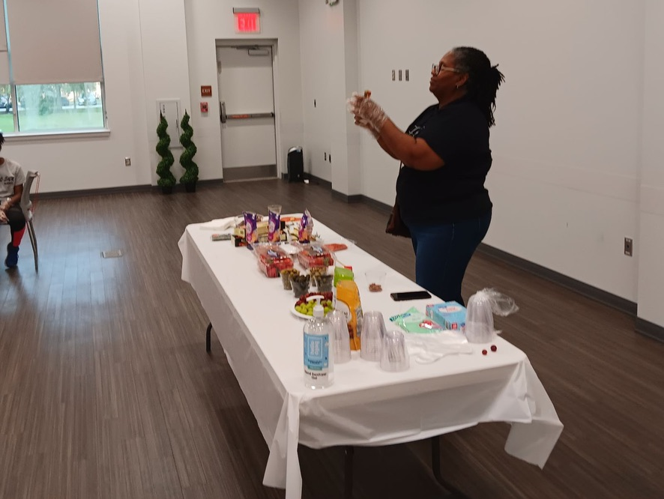
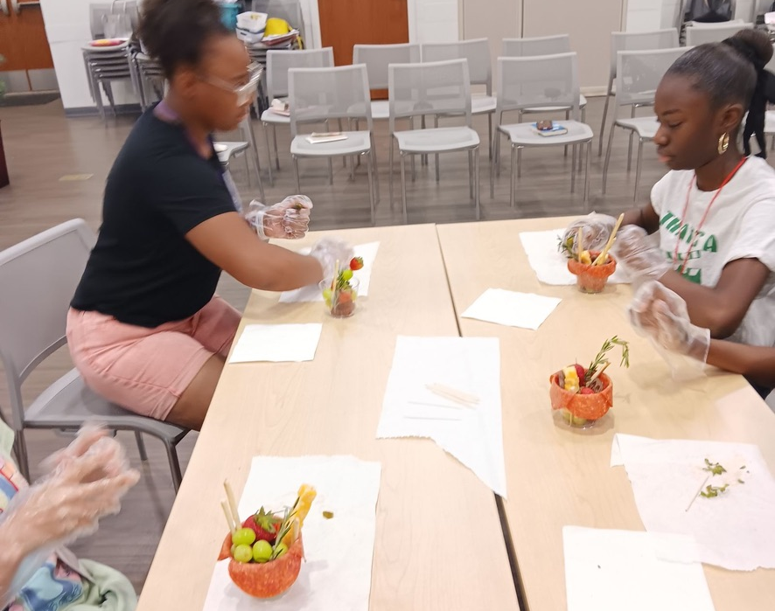
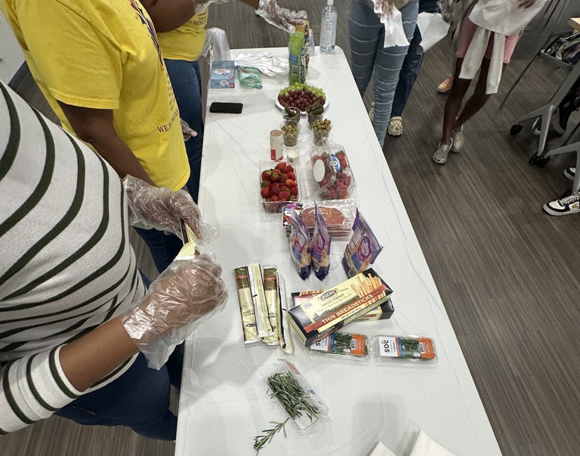

Slide 19
THANK YOU TO ALL OF OUR PARENTS!!!! WE COULD NOT DO THIS WITHOUT YOU!!

Slide 20
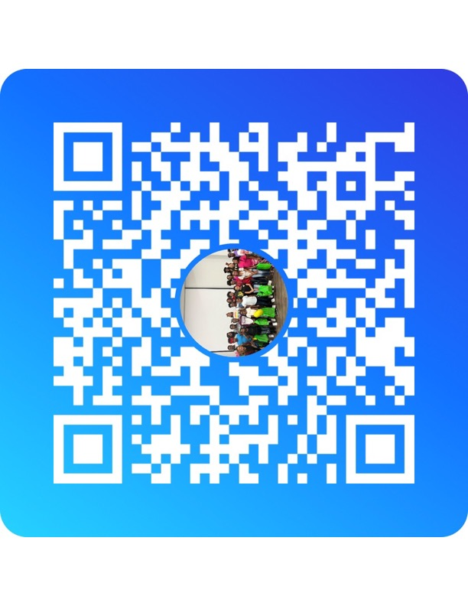
WHAT’S NEXT!!!!!!
OUR FOCUS: GIRLS IN LEADERSHIP
SCAN THE GROUPME QR CODE BELOW TO STAY UP TO DATE ON OUR BOOK CLUB MEETINGS

